Slide 1
Small Retail Store
Kainen Osborne

Slide 2
Overview
Develop a database capable of managing customers, sellers, products, orders, inventory, and reviews.
Support both operational transactions and business intelligence reporting.
Provide a dashboard that allows stakeholders to monitor inventory, sales performance, customer activity, and product trends.
Notes:
The goal of this project was to build a database that could support the core operations of an online marketplace. The database needed to store information about customers, sellers, products, inventory, orders, and reviews.

Slide 3
Key Requirements
Store customer and seller account information.
Track product inventory and stock levels.
Record orders and order details.
Support product reviews and ratings.
Categorize products for reporting and analysis.
Generate dashboard visualizations from database queries.
Notes:
Some of the primary requirements included tracking customer purchases, maintaining inventory levels, managing product categories, recording product reviews, and supporting reporting through a dashboard. The database was designed not only to handle transactions but also to provide meaningful business insights through analytics.

Slide 4
Analysis Phase
Business Needs Identified
Customers must be able to place orders containing multiple products.
Sellers must manage products and inventory.
Inventory levels need to be monitored to prevent stock shortages.
Management requires insight into sales performance and customer behavior.
Product ratings and reviews should be available for quality monitoring.
Challenges Addressed:
Eliminating duplicate customer and product information.
Maintaining referential integrity through foreign keys.
Supporting both transactional operations and analytical reporting.
Designing a structure that could scale with additional products and users.
Notes:
During the analysis phase, I first identified the major business processes involved in an online marketplace. These included customer purchasing, seller product management, inventory tracking, and product reviews. From these requirements I identified the core entities and their relationships. The goal was to create a database that could support both daily business operations and reporting needs for the dashboard.

Slide 5
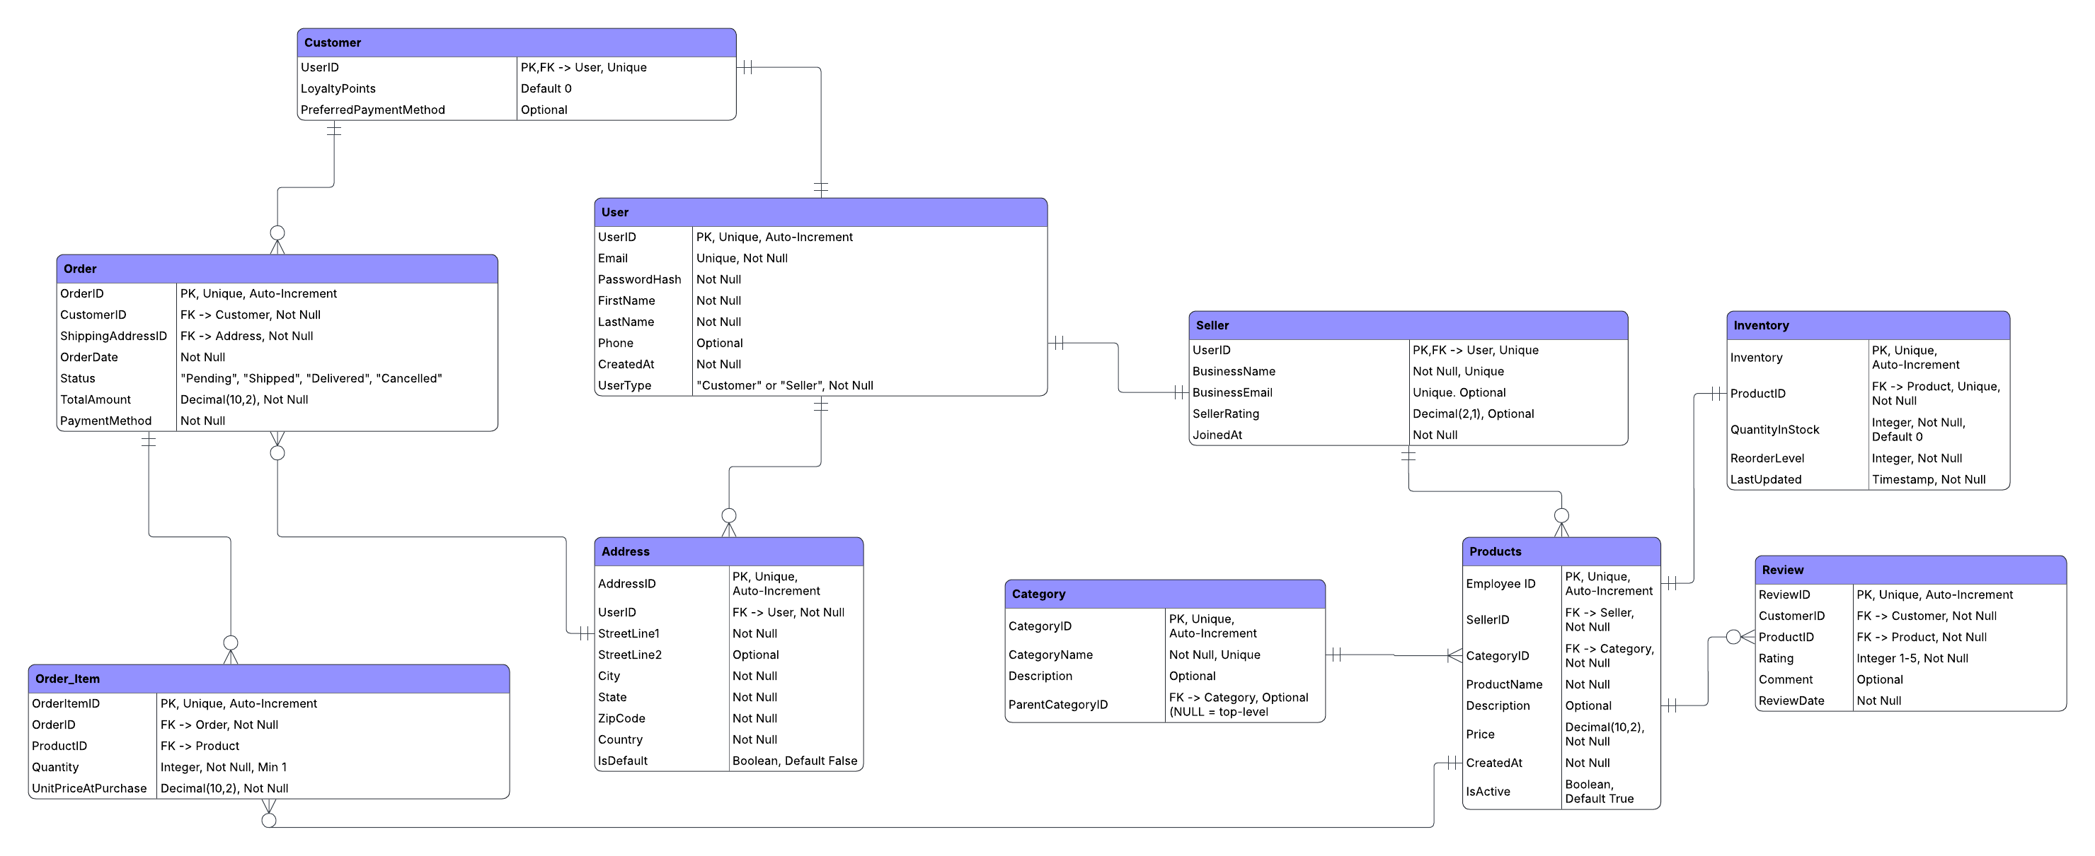
Initial Model
Notes:
This slide shows my initial database design before normalization.
At this stage, the design focused primarily on capturing all of the required data and relationships. While functional, the initial structure is a bit of a mess and has some incorrect aspects.
For example, customer information, order details, and product information could potentially be duplicated across multiple records. These issues would increase storage requirements and make updates more difficult to maintain consistently."

Slide 6
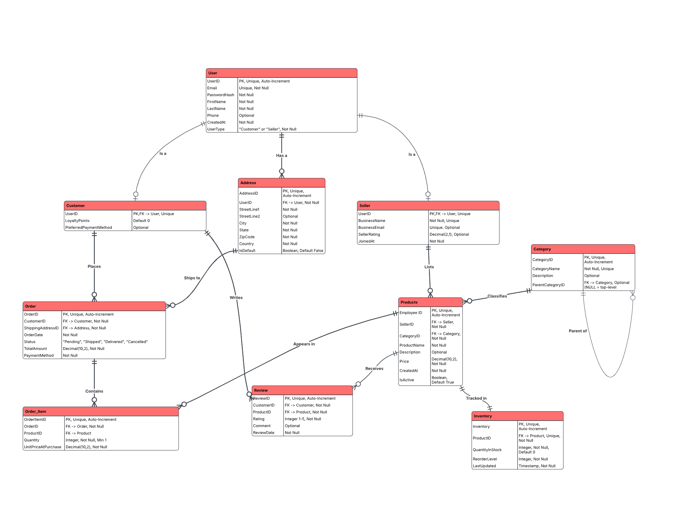
Normalized Final Model
Notes:
"After creating the initial design, I normalized the database to reduce redundancy and improve data integrity.
First Normal Form ensured that each field contained only atomic values and eliminated repeating groups.
Second Normal Form removed partial dependencies by ensuring that non-key attributes depended on the entire primary key.
Third Normal Form removed transitive dependencies, ensuring that non-key attributes depended only on the primary key.
The result was a cleaner and more efficient database structure that minimized duplication and improved maintainability.
The User table serves as the foundation for both customers and sellers. Orders are connected to customers, while Order_Item acts as a junction table between orders and products.
Products are linked to sellers, categories, inventory records, and reviews. Addresses are separated into their own table to support multiple addresses per user.
Primary and foreign key relationships enforce referential integrity and ensure consistent data throughout the database."

Slide 7
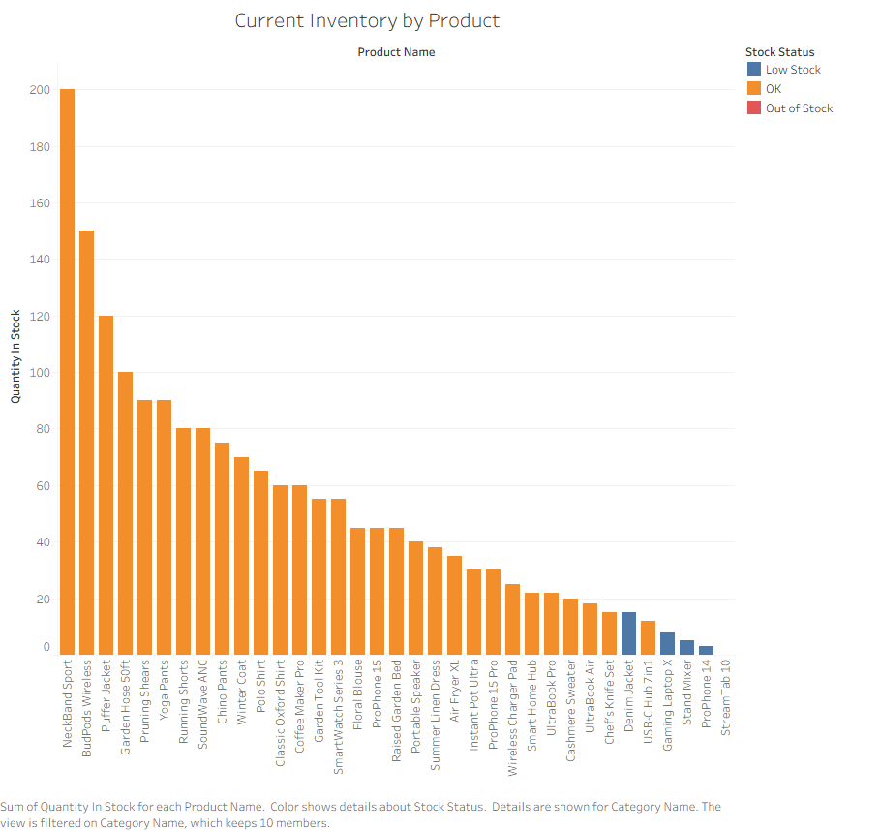
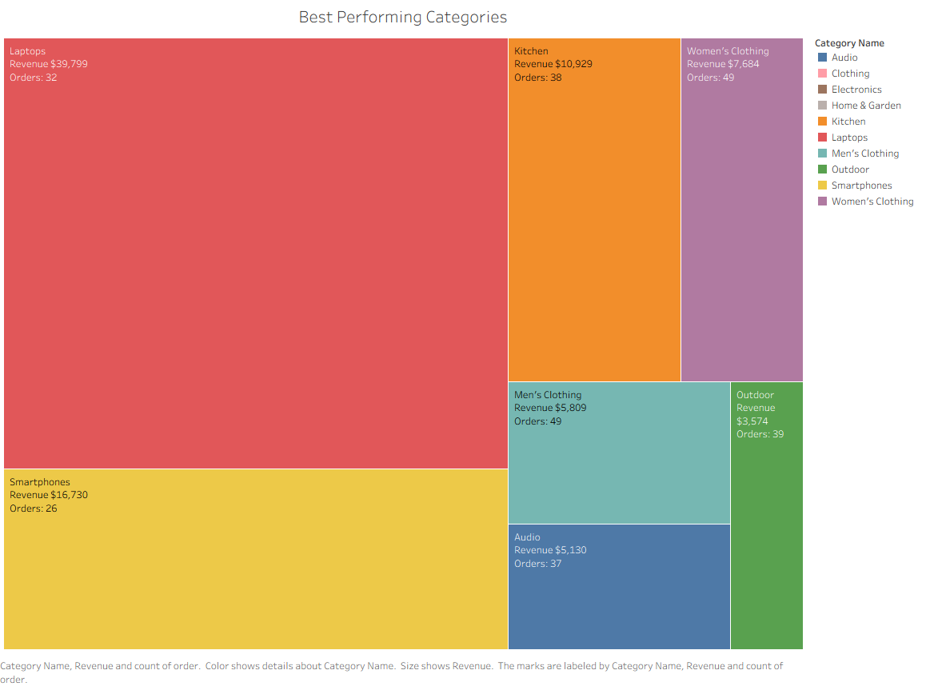
Dashboard Features

Slide 8
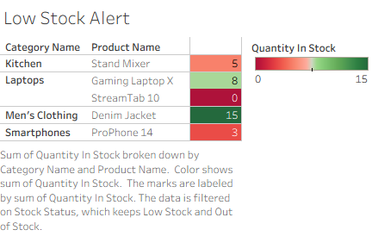
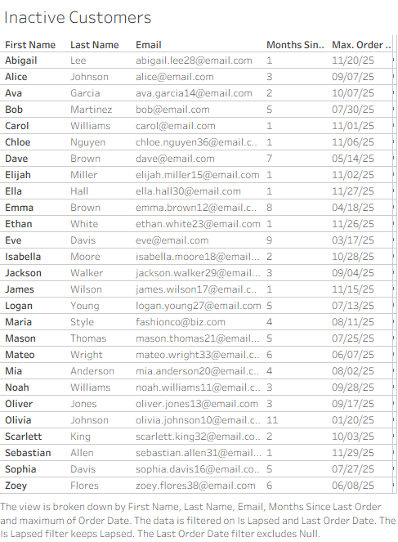
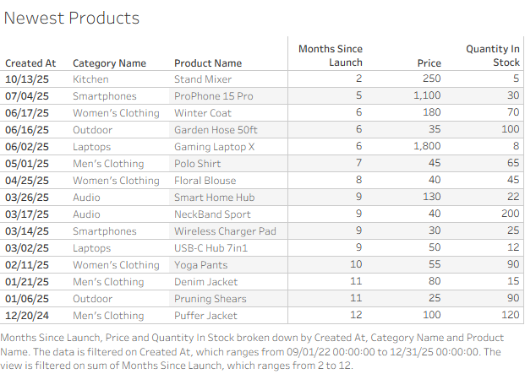
Dashboard Features 2.0

